Slide 1
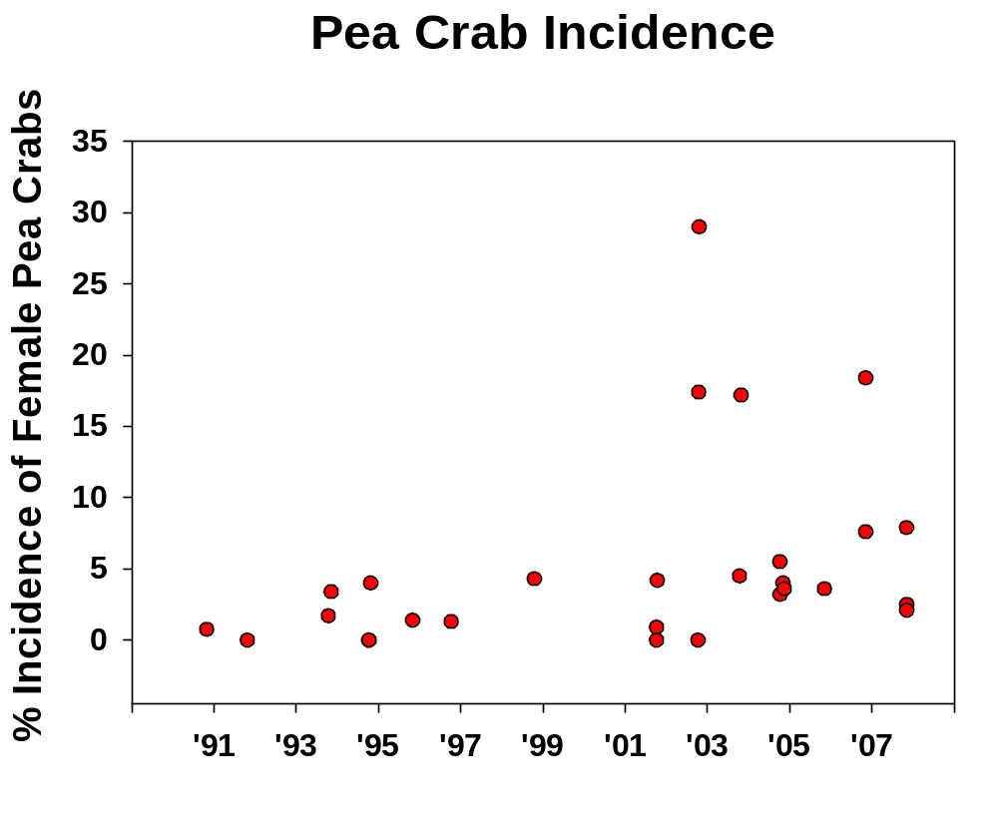
Figure . Percent incidence of female pea crabs, Tumidotheres (=Pinnotheres) maculatus, in adult bay scallops collected from October-November, 1990-2007. Linear regression of arcsin √ % incidence vs. year: F = 7.50; p = .011; R² = .224.

